Slide 1
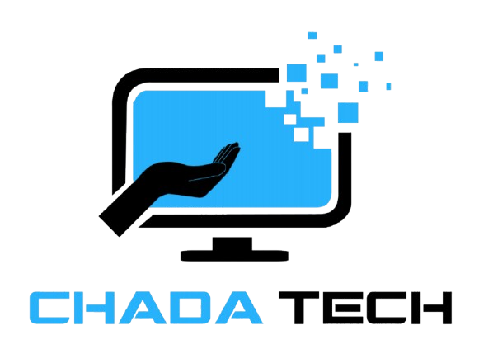
Agile vs waterfall
Justin Perez

Slide 2
What is agile?

Slide 3
Agile core concepts
Priories People
Agile Focuses on the team
Customer Collaboration
Agile ensures Customer satisfaction as they are apart of the process
Working Software
In Agile the product will be constantly testing which gives feedback immediately
Simplicity
Agile breaks down harder components into simpler ones for everyone

Slide 4
Agile Roles

Slide 5
Product Owner
Product Owner
Manage Scrum Backlog
Set Product Vision
Communicate with external stockholders
Ensure the team is focused on features

Slide 6
Scrum Master
Scrum Master
Organizes Team
Focuses on Communication
Break Hard concept to simple components
Graphs, Diagrams, & Charts

Slide 7
Developer
Developer
Creates Project
Assist in Sprint planning
Find the best development Practices
Ensure high quality maintainable products with scalability in mind

Slide 8
Tester
Tester
Keeps Project Quality High
Communicates with dev team
Allows for Dev team to focus on feature implementation
Locate Potential Blockers

Slide 9
Agile Phases

Slide 10
Requirement Gathering
Design & Development
Development & Feedback
Frequent releases & Fast Customer Feedback
User Stories and Backlog Refinement
Testing & Integration
Continuous Testing & Intergration
Iterative Sprint for Improvement

Slide 11
Why Agile?
Adaptable
Fast Development
High Quality Products
Higher customer satisfaction
Higher Team Satisfaction
Quick Delivery

Slide 12
What is Waterfall?

Slide 13
Waterfall core concepts
Sequential Approach
Implements 1 after another
Document-Driven
Project is well documented, and teams works toward a clear goal
Quality Control
You must complete to a release build 1 feature before continuing
Rigorous Planning
Requires planning for project scope, timelines, and deliverable products

Slide 14
Waterfall Phases

Slide 15
Requirement Gathering
Gather ALL information immediately from stake holds and give an estimation under scope
Design
Create a detailed design document that outlines everything. Especially user interface and Components.
Development
Testing
Deployment & Maintenance
Once the software is tested & approved it will be instantly deployed
Maintenance will also have to be done time to time
The Features should be added one after each other and fully completed before going further
Before full deploying a feature, it should be fully tested to ensure no bugs are present

Slide 16
Why Waterfall?
Clarity & Simplicity
Documentation
Resource optimization
Stability in Requirement
Clearly Defined Phases

Slide 17
Agile vs waterfall
Agile
Waterfall
Requirements
Requirements change Often
Doesn’t know what they fully want
Feedback
Customer Feedback is needed for this project
Speed
Speedy Delivery is necessary
Adaptability is in priorities
Owner wants to be included
Customers are the priority
Requirements
Requirements are fixed
Owner knows exactly what they want and when
Budget
Timeline is strict
Budget is static though the entire project
Small Project
Projects are simple in scope
Project requires minimal changes in the future
Owner doesn’t want to be included
Predictable income and outcomes

Slide 18
Conclusion

Slide 19
Agile is better for Chadatech
Flexibility
Agile offers flexibility needed in this project
Customer Feedback
Customer feedback is necessary in this project which is why it’s necessary for it to be agile
Team Prioritization
A happier team produces more work. According to oxford it can increase output by 14%

Slide 20
References
The 3 scrum roles and responsibilities explained. Coursera. (n.d.). https://www.coursera.org/articles/scrum-roles-and-responsibilities
Atlassian. (n.d.). A deep dive into scrum team roles. https://www.atlassian.com/agile/scrum/roles
GeeksforGeeks. (2022, November 17). What are the 4 agile values? https://www.geeksforgeeks.org/what-are-the-4-agile-values/
GeeksforGeeks. (2024, October 18). Waterfall Model - Software Engineering. https://www.geeksforgeeks.org/waterfall-model/
Happy workers are 13% more productive. University of Oxford. (n.d.). https://www.ox.ac.uk/news/2019-10-24-happy-workers-are-13-more-productive
Mijacobs. (n.d.). What is agile? - azure DevOps. Azure DevOps | Microsoft Learn. https://learn.microsoft.com/en-us/devops/plan/what-is-agile
team, Profit. co. (2023, June 14). The 5 phases of Waterfall Project Management. Best OKR Software by Profit.co. https://www.profit.co/blog/task-management/the-5-phases-of-waterfall-project-management/

